Slide 1
Electronic Instrumentation Section-1, Ppt-11

Slide 2
EMI/EMC

Slide 3
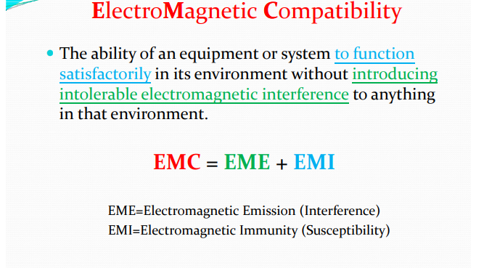

Slide 4
EMC = EME + EMI
EME=Electromagnetic Emission (Interference) EMI=Electromagnetic Immunity (Susceptibility)
The absence of Electromagnetic Interference (EMI) in a system is called Electromagnetic Compatibility (EMC).
EMC implies a balance: Don‘t disturb others and don‘t get disturbed by them.

Slide 5
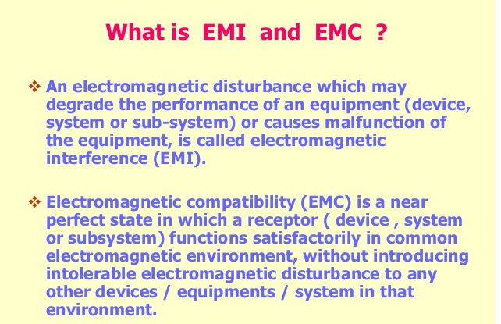

Slide 6
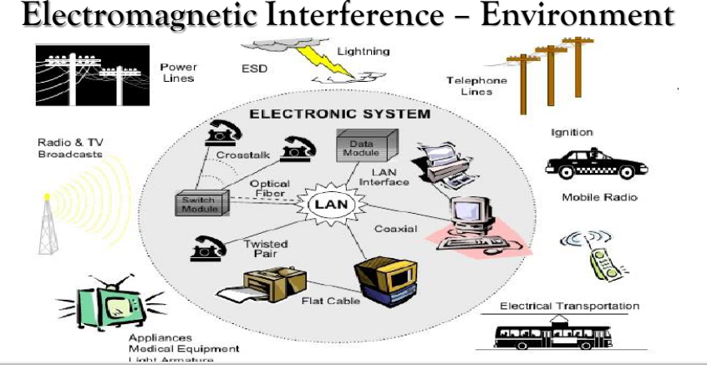

Slide 7
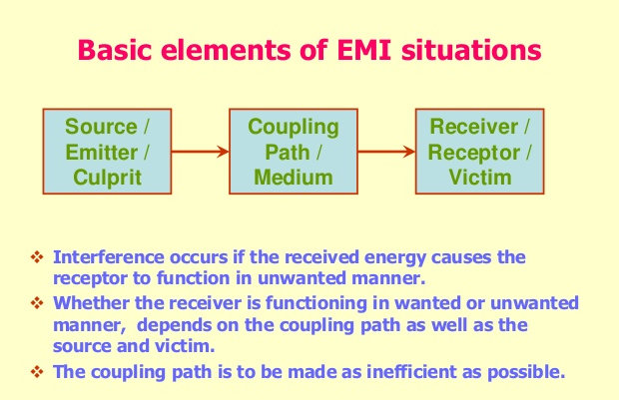

Slide 8
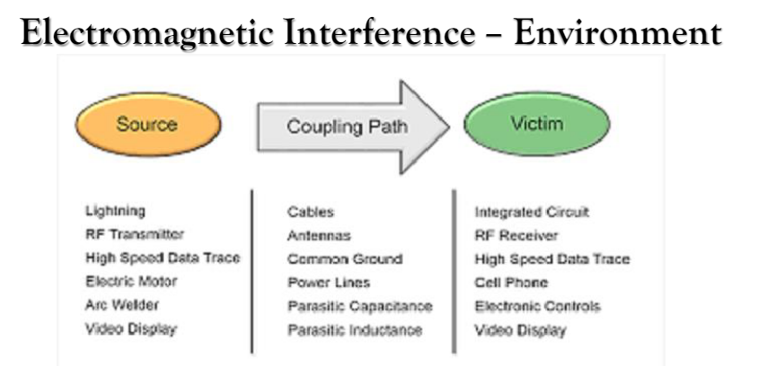

Slide 9
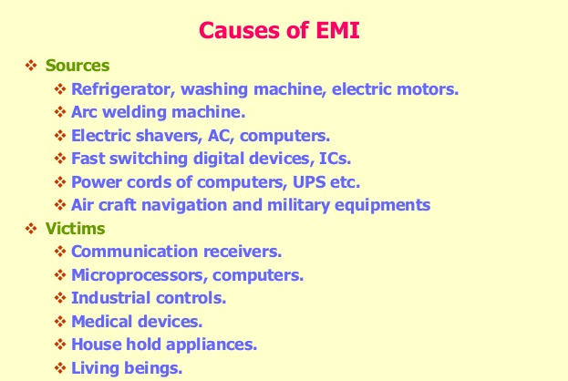

Slide 10
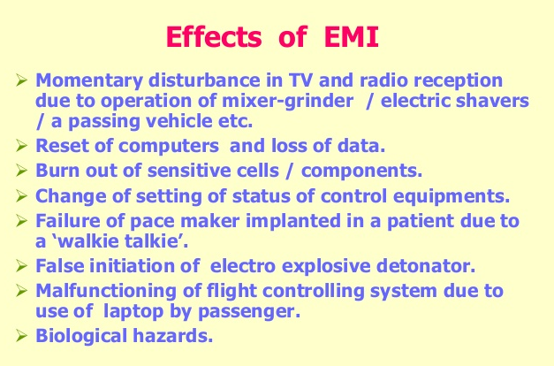

Slide 11
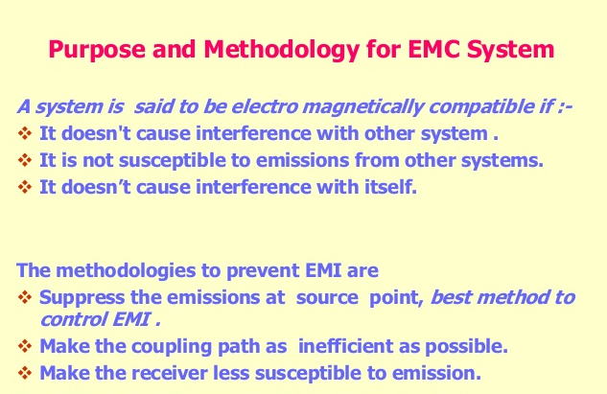

Slide 12
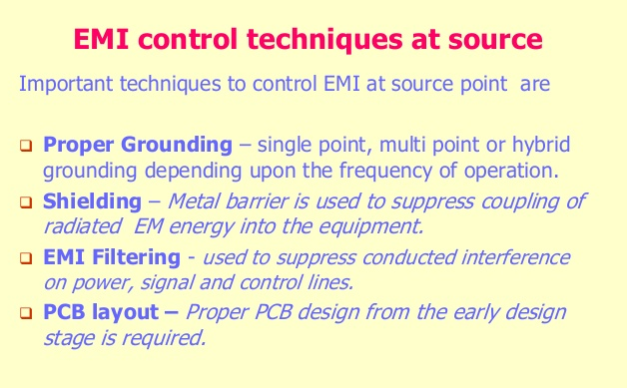

Slide 13
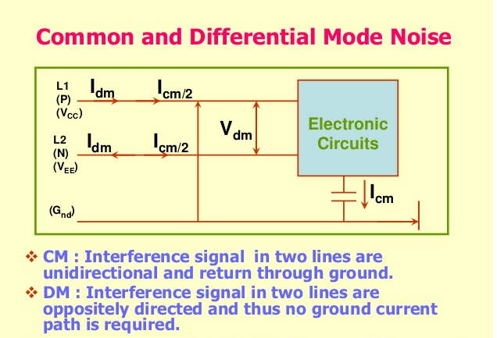

Slide 14
EMI solutions
The EMC problem structure suggests three basic EMI fighting methods:
(1) Change the noise characteristics at the source. Promising parameters are amplitude, frequency, di/dt. This is always the first option because curing one source problem may solve many receptor problems.
(2) Improve the immunity of the receptor. Proper grounding may help here.
(3) Break the coupling path. For this we use shields, filters, common mode chokes and such. These methods are not strictly separated from each other, which doesn’t matter because in most cases all of them are employed at the same time.

Slide 15
> Capacitive coupling by electric near fields: unexpected shortcuts @ high f
> Inductive coupling by magnetic near fields: a nuisance @ low f
> Radiation coupling by electromagnetic far fields
> Galvanic coupling by conductive connections
Galvanic coupling comes in various forms:
> Pickup on power and other supply lines, even through shields
> Common impedance coupling: current 1 modulates voltage 2

Slide 16
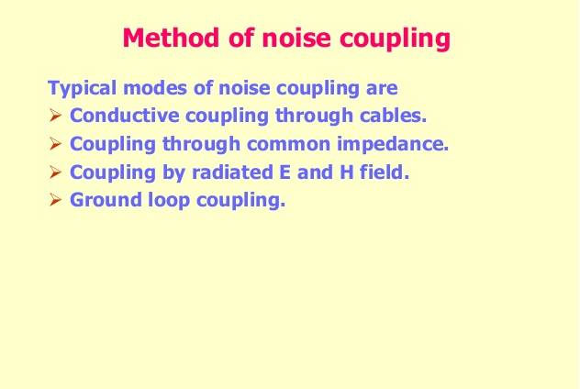

Slide 17
EMC standards
EMC standards define terms, rules, test methods, emission limits and immunity levels for Electromagnetic Compatibility (EMC).

Slide 18
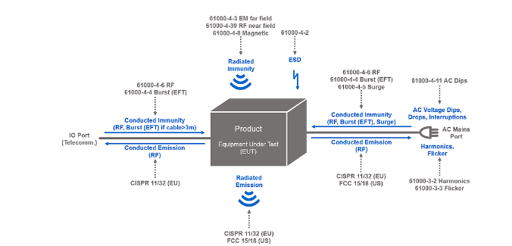

Slide 19
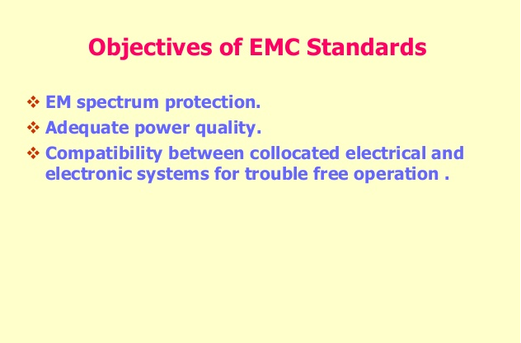

Slide 20
Who writes EMC Standards?
Norms and standards in EMC are either defined and worded by international and national or regional organizations and committees on behalf of administrative bodies (like the EU delegates the wording of EMC Standards to CENELEC), or the administrative and/or regulatory bodies word the EMC Standards and regulations themselves.

Slide 21
What types of EMC Standards are there?
General. Guide on how to draft an EMC publication, definition of the EMC terminology and vocabulary, general considerations. Examples: IEC Guide 107, IEC 60050-161, IEC TR 61000-1-1 etc.
Environment. Classification and description of different electromagnetic environments and compatibility levels. Examples: IEC TS 61000-2-5 IEC TR 61000-2-3, etc.
Emission. Definition of test setups, testing techniques, test equipment, test environment and other considerations regarding EMC emission testing and measurement. Examples: IEC 61000-4-7, IEC 61000-4-14, CISPR 16, etc.
Immunity. Definition of test setups, testing techniques, test equipment, test environment and other considerations regarding EMC immunity testing. Examples: IEC 61000-4-1, IEC 61000-4-2, IEC 61000-4-3, etc.
Installation/Mitigation. Installation and mitigation guidelines regarding earthing and cabling, mitigation of external electromagnetic influences, HEMP protection concepts and so on. Examples are IEC TR 61000-5-1, IEC TR 61000-5-2, etc.

Slide 22
International Electrotechnical Commission (IEC)
India
Bureau of Indian Standards (BIS)​
Japan
Japanese Industrial Standards Committee (JISC)
Japanese Standards Association (JAS)
Korea
Korean Standards Association (KSA)​

Slide 23
Electrostatic discharge (ESD)
Electrostatic discharge (ESD) is the sudden flow of electricity between two electrically charged objects caused by contact, an electrical short, or dielectric breakdown.

Slide 24
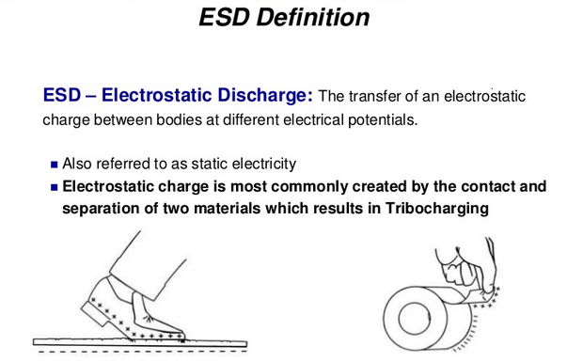

Slide 25
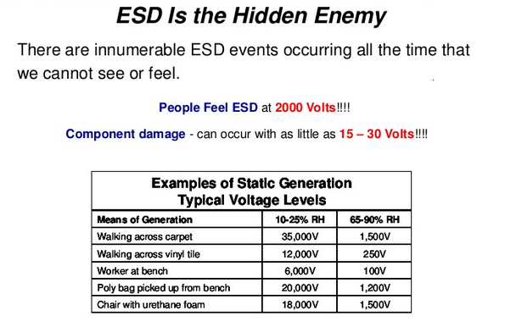

Slide 26
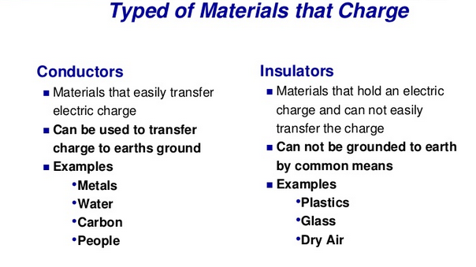

Slide 27
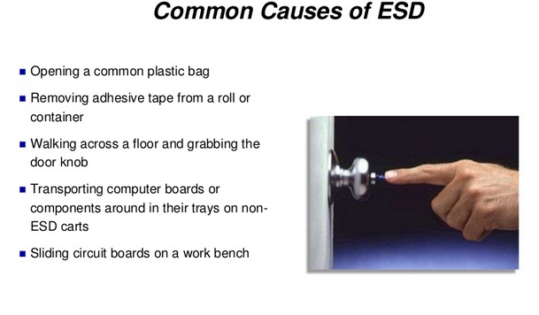

Slide 28
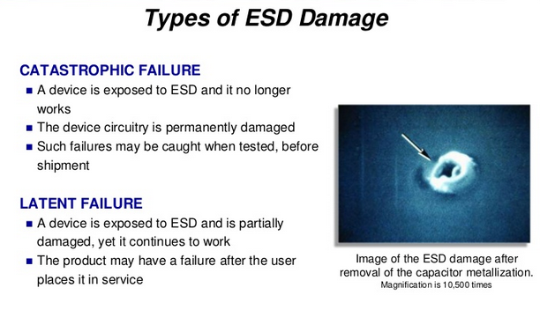

Slide 29
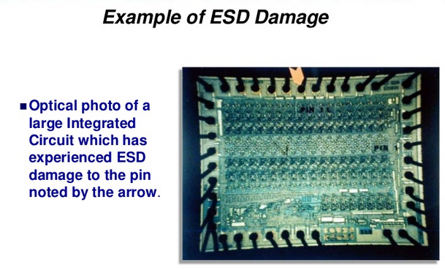

Slide 30
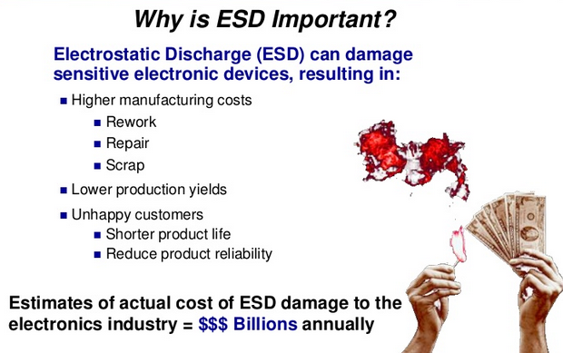

Slide 31
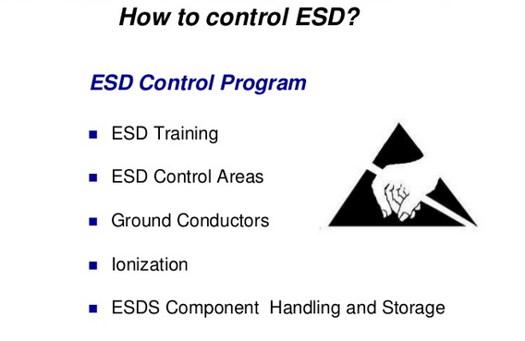

Slide 32
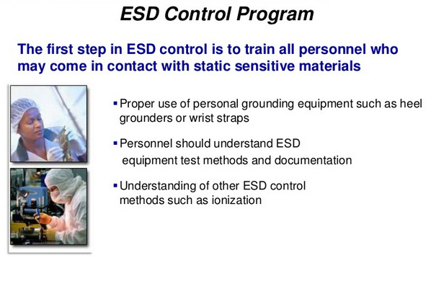

Slide 33
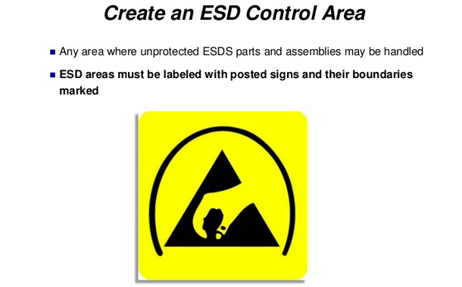

Slide 34
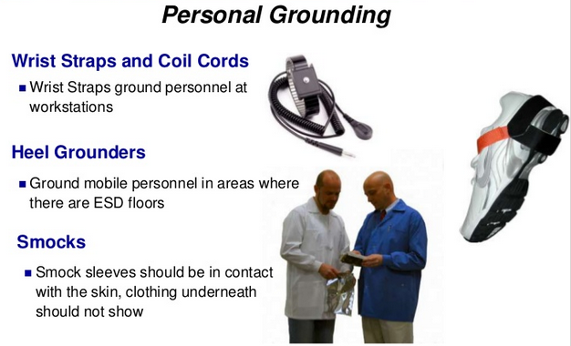

Slide 35
In EMC signal, the source delivers maximum power to the input of transmission line when the transmission line input impedance
a. Is equal to the source resistance b. Greater than the source resistance c. Smaller than the source resistance d. None of these

Slide 36
The effects of EMI can be reduced by a. Suppressing emissions b. Reducing the efficiency of the coupling path c. Reducing the susceptibility of the receptor d. All of these

Slide 37
The opposite of susceptibility is a. Immunity b. Emission c. Interference d. Electromagnetic compatibility

Slide 38
The ability of an electronic system to function properly in its intended electromagnetic environment and should not be a source of pollution to that electromagnetic environment is known as
a. Susceptibility b. Emission c. Interference d. Electromagnetic compatibility

Slide 39
The man made noise sources is / are a. Motors b. Switches, radio interferences c. Computers, digital electronics d. All of these

Slide 40
What form of noise is produced as a result of random variations in the diffusion of charge carriers within devices?
Short noise
Flicker noise
Interference
Johnson noise

